Slide 1

Geometry
Unit 12, Lesson 7 Deriving the Equation of a Circle Volume 2 pg. 260

Slide 2


Benchmark
MA.912.GR.7.2
Given a mathematical or real-world context, derive and create the equation of a circle using key features.
volume 2, pg. 260

Slide 3
Integrated Mathematical Thinking and Reasoning Standards
MA.K12.MTR.1.1 Actively participate in effortful learning both individually and collectively.
MA.K12.MTR.2.1 Demonstrate understanding by representing problems in multiple ways.
MA.K12.MTR.4.1 Engage in discussions that reflect on the mathematical thinking of self and others.
MA.K12.MTR.5.1 Use patterns and structure to help understand and connect mathematical concepts.
volume 2, pg. 260

Slide 4

Learning Targets
I can use the Pythagorean Theorem to derive the equation of a circle.
I can determine key features of a circle given the graph or equation.
I can write the equation of a circle using key features.
volume 2, pg. 260

Slide 5

Warm-Up
volume 2, pg. 261

Slide 6
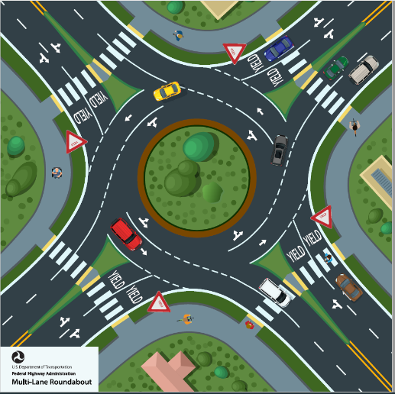
12.7.1 Warm-Up: Roundabouts
Roundabouts promote a continuous flow of traffic because drivers do not have to wait for a green light at a roundabout to get through the intersection. A diagram of a roundabout is shown.
What do you wonder about the diagram?
How many different paths could the red car take?
List at least two things you have studied in Geometry so far that may be helpful to know when constructing a roundabout.
volume 2, pg. 261

Slide 7

Exploration
volume 2, pg. 261

Slide 8

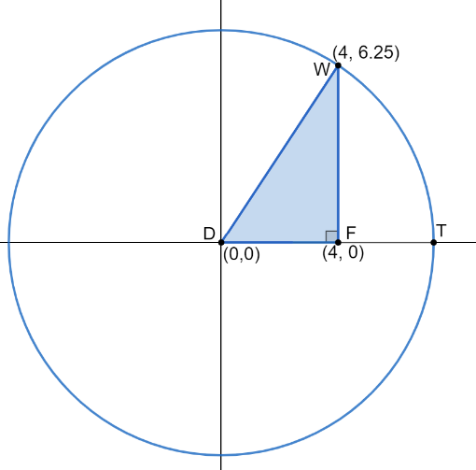
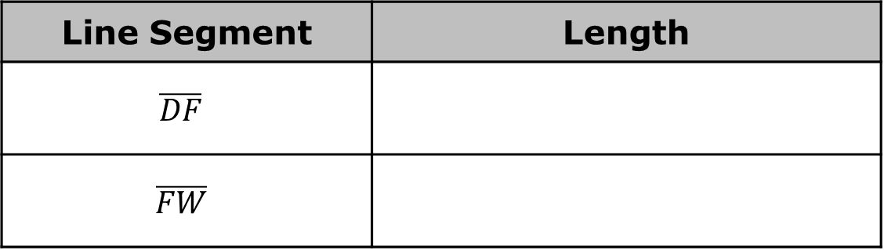
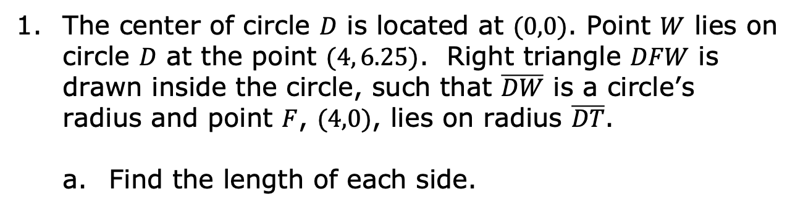
12.7.2 Exploration: Deriving the Equation of a Circle
The center of circle $D$ is located at $(0,0)$. Point $W$ lies on circle $D$ at the point $(4, 6.25)$. Right triangle $DFW$ is drawn inside the circle, such that $\overline{DW}$ is a circle’s radius and point $F$, $(4,0)$, lies on radius $\overline{DT}$.
Find the length of each side.
Line Segment | Length
$$\overline{DF}$$
$$\overline{FW}$$
volume 2, pg. 261

Slide 9
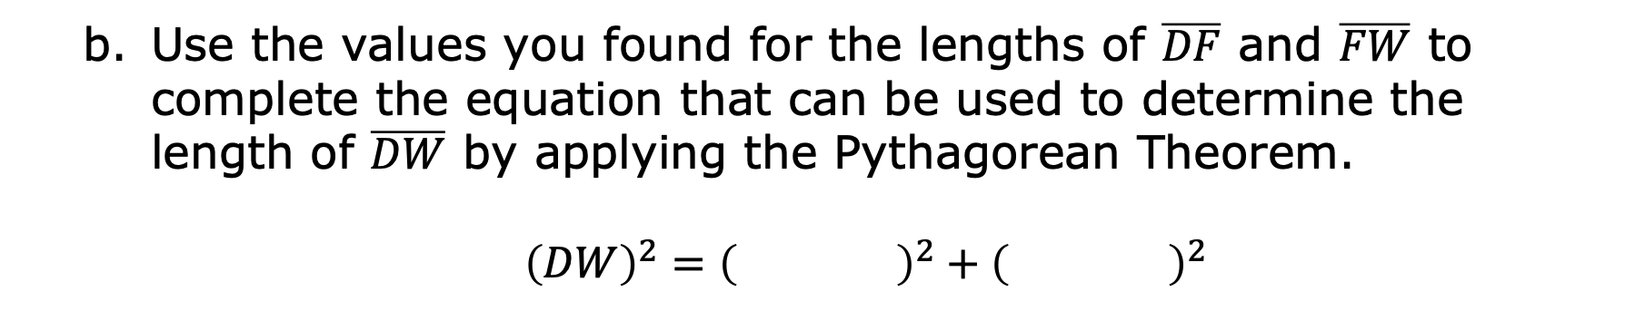
Use the values you found for the lengths of $\overline{DF}$ and $\overline{FW}$ to complete the equation that can be used to determine the length of $\overline{DW}$ by applying the Pythagorean Theorem.
${\left(DW\right)}^{2}={\left( \right)}^{2}+{\left( \right)}^{2}$
volume 2, pg. 261

Slide 10
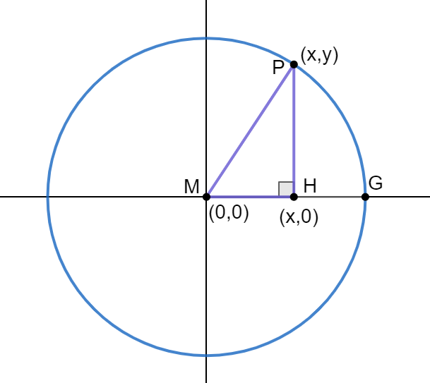
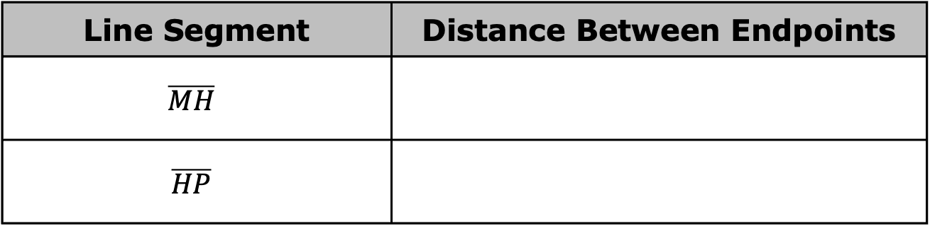
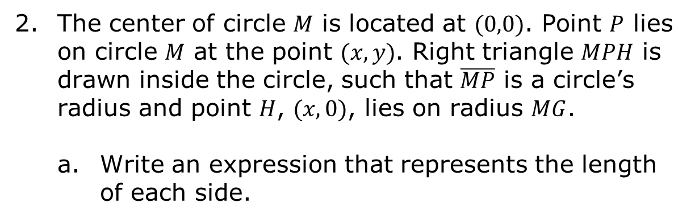
The center of circle $M$ is located at $(0,0)$. Point $P$ lies on circle $M$ at the point $(x, y)$. Right triangle $MPH$ is drawn inside the circle, such that $\overline{MP}$ is a circle’s radius and point $H$, $(x,0)$, lies on radius $MG$.
Write an expression that represents the length of each side.
Line Segment | Distance Between Endpoints
$$\overline{MH}$$
$$\overline{HP}$$
volume 2, pg. 262

Slide 11
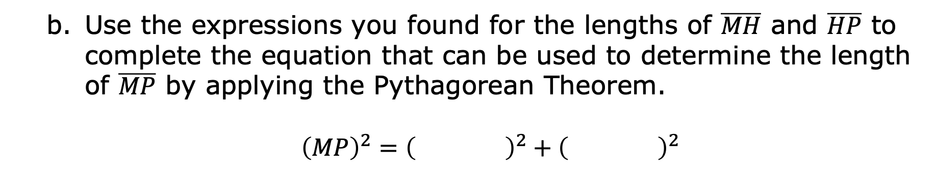
Use the expressions you found for the lengths of $\overline{MH}$ and $\overline{HP}$ to complete the equation that can be used to determine the length of $\overline{MP}$ by applying the Pythagorean Theorem.
${\left(MP\right)}^{2}={\left( \right)}^{2}+{\left( \right)}^{2}$
volume 2, pg. 262

Slide 12
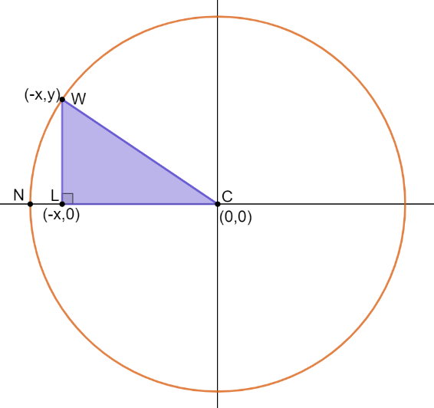

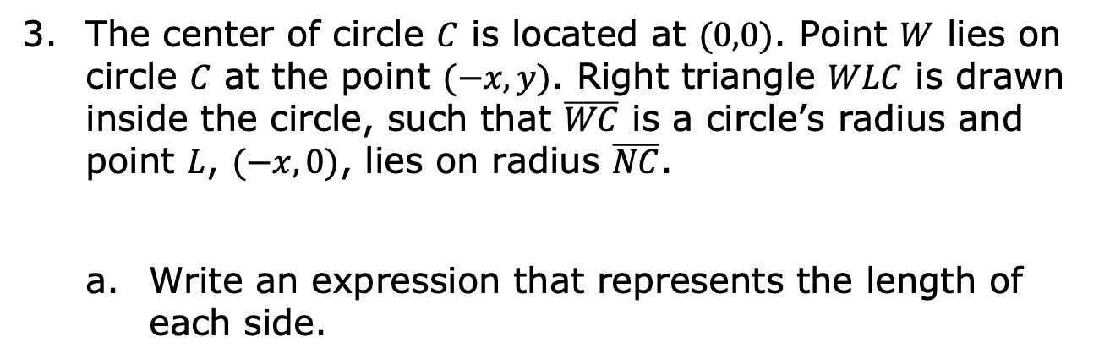
The center of circle $C$ is located at $(0,0)$. Point $W$ lies on circle $C$ at the point $(−x, y)$. Right triangle $WLC$ is drawn inside the circle, such that $\overline{WC}$ is a circle’s radius and point $L$, $(−x,0)$, lies on radius $\overline{NC}$.
Write an expression that represents the length of each side.
Line Segment | Distance Between Endpoints
$$\overline{LC}$$
$$\overline{LW}$$
volume 2, pg. 262

Slide 13
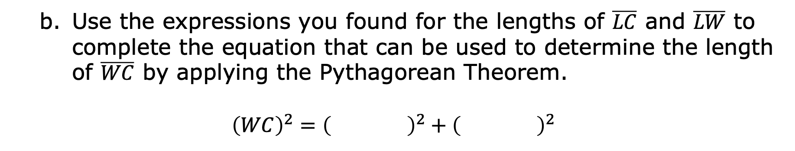
Use the expressions you found for the lengths of $\overline{LC}$ and $\overline{LW}$ to complete the equation that can be used to determine the length of $\overline{WC}$ by applying the Pythagorean Theorem.
$${\left(WC\right)}^{2}={\left( \right)}^{2}+{\left( \right)}^{2}$$
volume 2, pg. 262

Slide 14
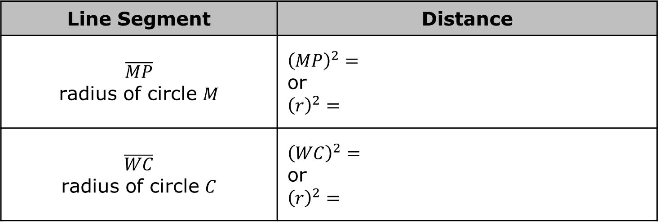

Complete the table with the equation you found that can be used to determine the length of the radius of each circle.
In circle $M$ and circle $C$, the location of the point on the circle was in a different location, but the equations that can be used to determine the length of the radius of the circles are the same.
Line Segment | Distance
$\overline{MP}$ radius of circle $M$ | $${\left(MP\right)}^{2}=$$ or $${\left(r\right)}^{2}=$$
$\overline{WC}$ radius of circle $C$ | $${\left(WC\right)}^{2}=$$ or $${\left(r\right)}^{2}=$$
volume 2, pg. 263

Slide 15
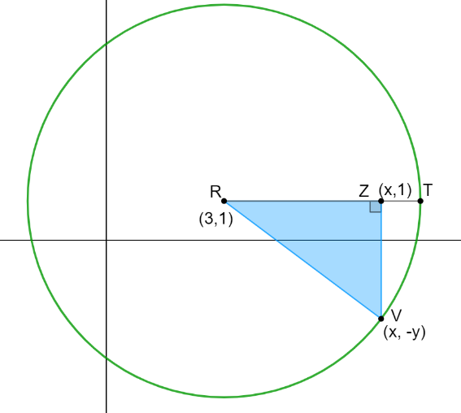
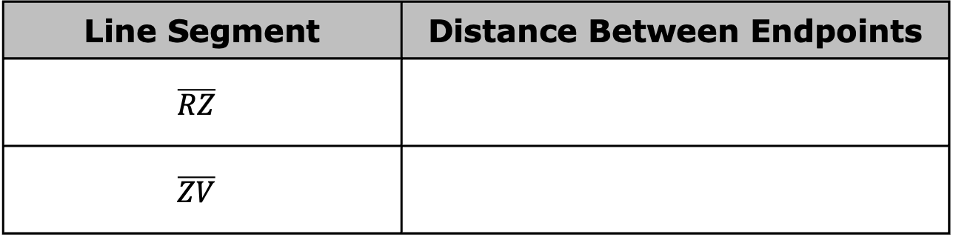
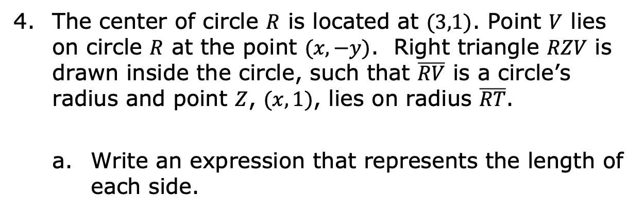
The center of circle $R$ is located at $(3,1)$. Point $V$ lies on circle $R$ at the point $(x, −y)$. Right triangle $RZV$ is drawn inside the circle, such that $\overline{RV}$ is a circle’s radius and point $Z$, $(x,1)$, lies on radius $\overline{RT}$.
Write an expression that represents the length of each side.
Line Segment | Distance Between Endpoints
$$\overline{RZ}$$
$$\overline{ZV}$$
volume 2, pg. 263

Slide 16
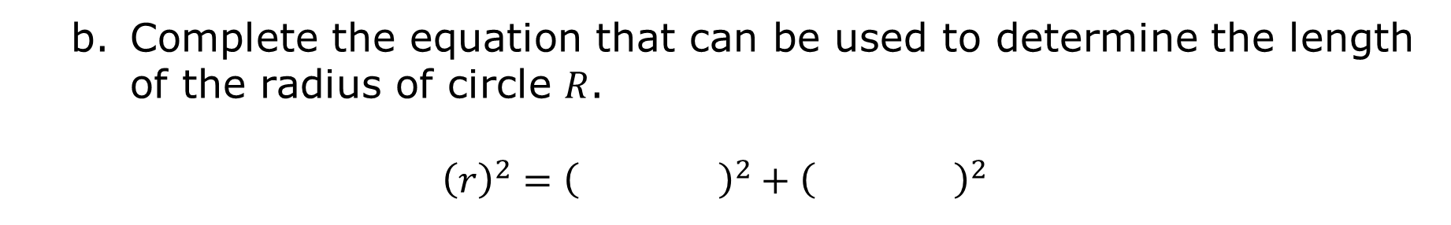
Complete the equation that can be used to determine the length of the radius of circle $R$.
$${\left(r\right)}^{2}={\left( \right)}^{2}+{\left( \right)}^{2}$$
volume 2, pg. 263

Slide 17
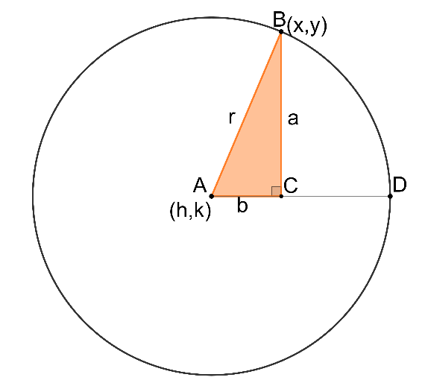
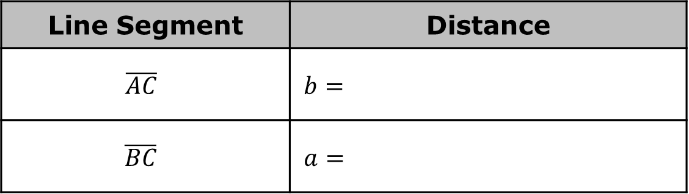
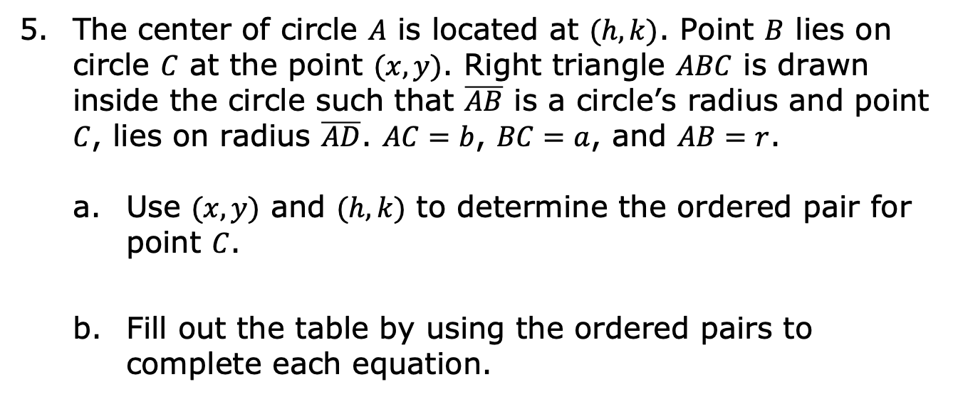
The center of circle $A$ is located at $(h,k)$. Point $B$ lies on circle $C$ at the point $(x, y)$. Right triangle $ABC$ is drawn inside the circle such that $\overline{AB}$ is a circle’s radius and point $C$, lies on radius $\overline{AD}$. $AC=b$, $BC=a$, and $AB=r$.
Use $(x, y)$ and $(h,k)$ to determine the ordered pair for point $C$.
Fill out the table by using the ordered pairs to complete each equation.
Line Segment | Distance
$$\overline{AC}$$ | $$b=$$
$$\overline{BC}$$ | $$a=$$
volume 2, pg. 264

Slide 18

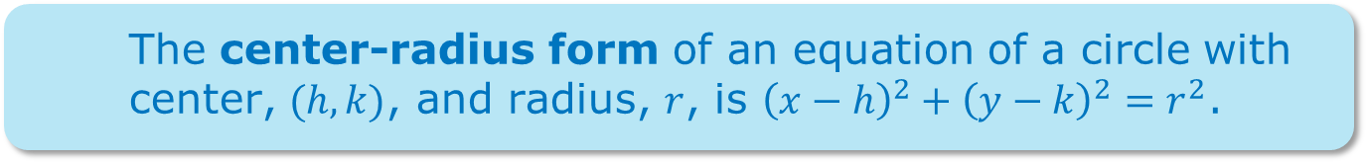
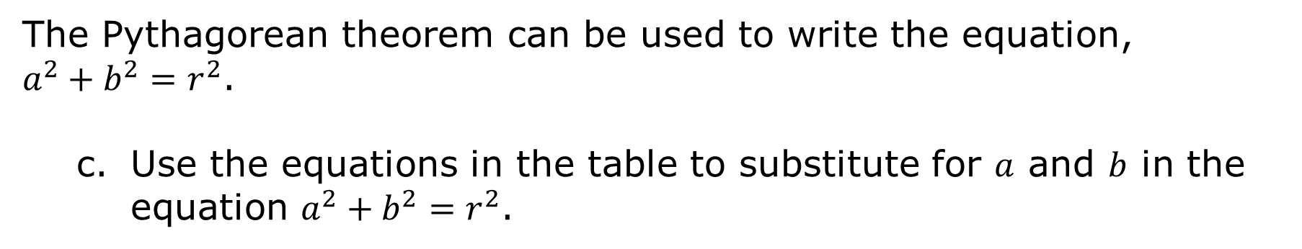
The Pythagorean theorem can be used to write the equation,
$a^{2}+b^{2}=r^{2}$.
Use the equations in the table to substitute for $a$ and $b$ in the equation $a^{2}+b^{2}=r^{2}$.
The center-radius form of an equation of a circle with center, $(h, k)$, and radius, $r$, is ${\left(x−h\right)}^{2}+{\left(y−k\right)}^{2}=r^{2}$.
volume 2, pg. 264

Slide 19

Guided Instruction
volume 2, pg. 265

Slide 20
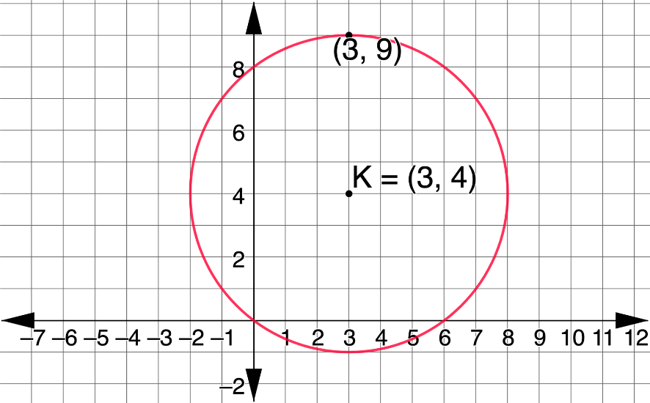
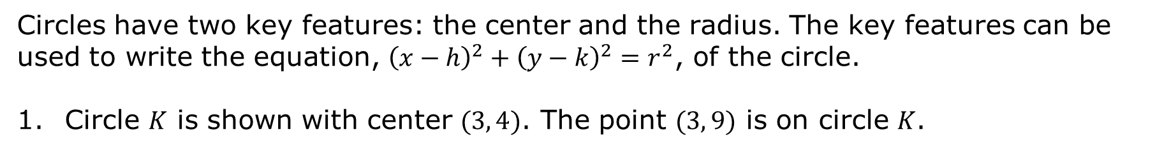
12.7.3 Guided Instruction: Key Features of a Circle
Circles have two key features: the center and the radius. The key features can be used to write the equation, ${\left(x−h\right)}^{2}+{\left(y−k\right)}^{2}=r^{2}$, of the circle.
Circle $K$ is shown with center $(3, 4)$. The point $(3, 9)$ is on circle $K$.
volume 2, pg. 265

Slide 21
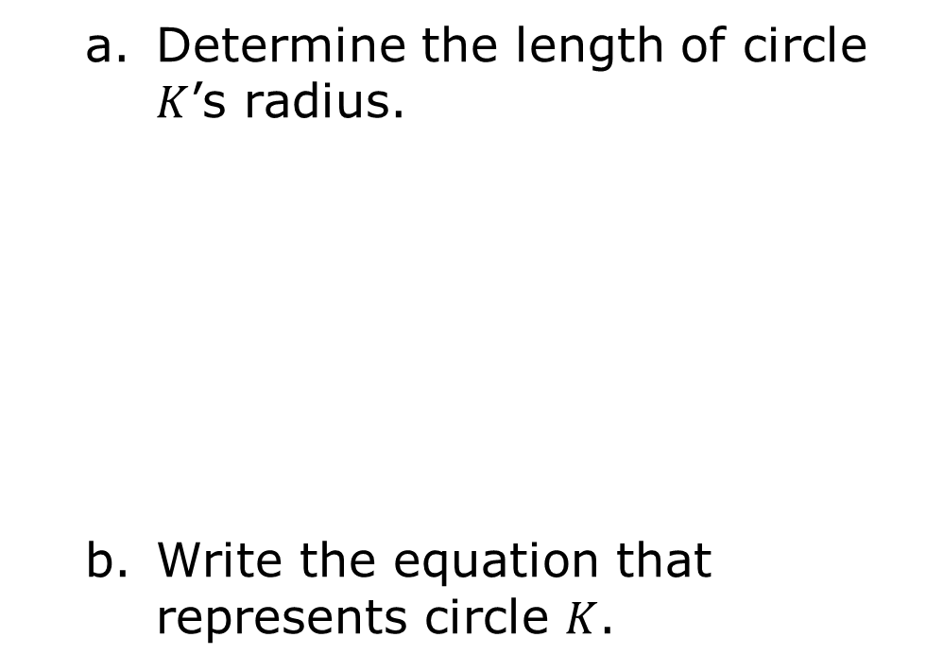
Determine the length of circle $K$’s radius.
Write the equation that represents circle $K$.
volume 2, pg. 265

Slide 22
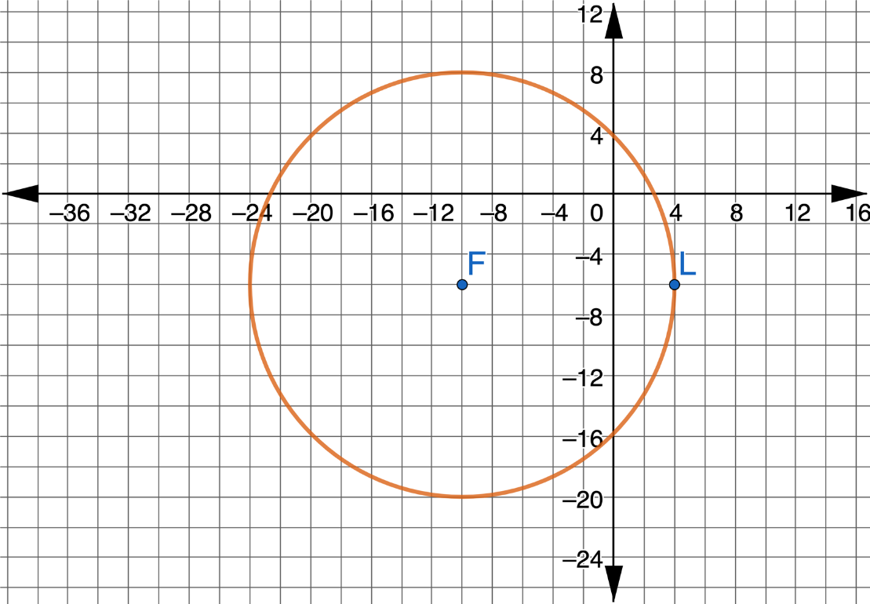
Circle $F$ is shown, where point $L$ is on the circle.
volume 2, pg. 265

Slide 23
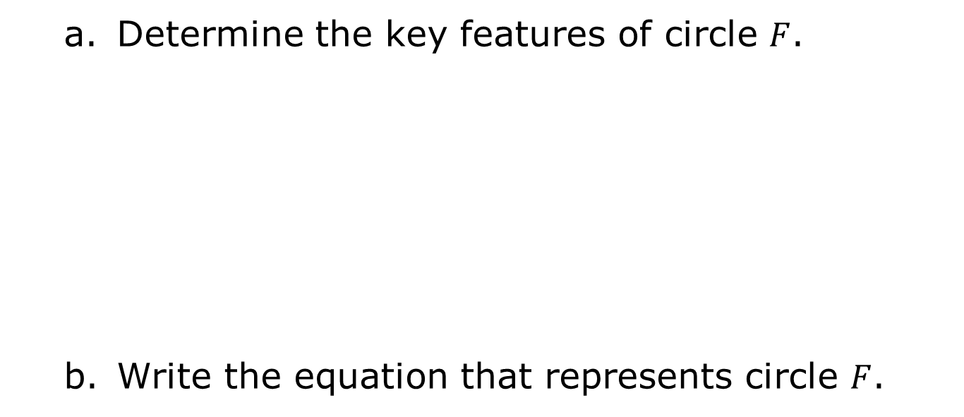
Determine the key features of circle $F$.
Write the equation that represents circle $F$.
Key Features
Radius
Center
volume 2, pg. 265

Slide 24

Wrap-Up
volume 2, pg. 266

Slide 25
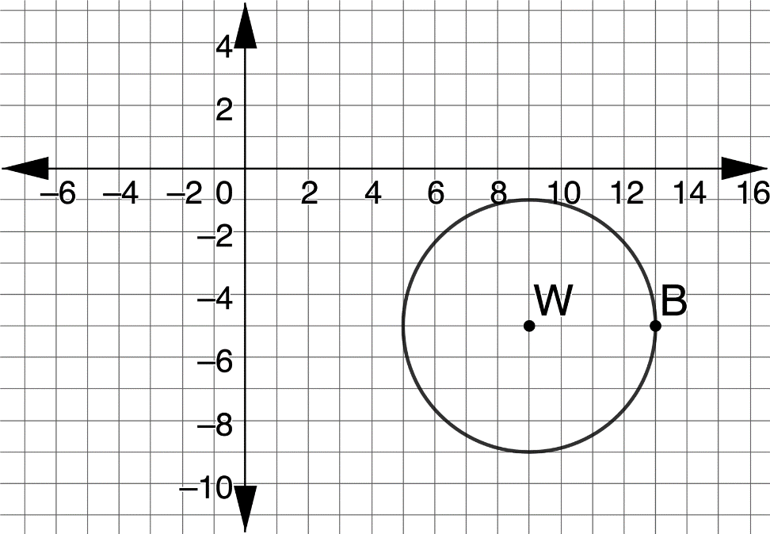
12.7.4 Wrap-Up: Ticket Out the Door
Circle $W$ is shown, where point $B$ is on the circle.
volume 2, pg. 266

Slide 26
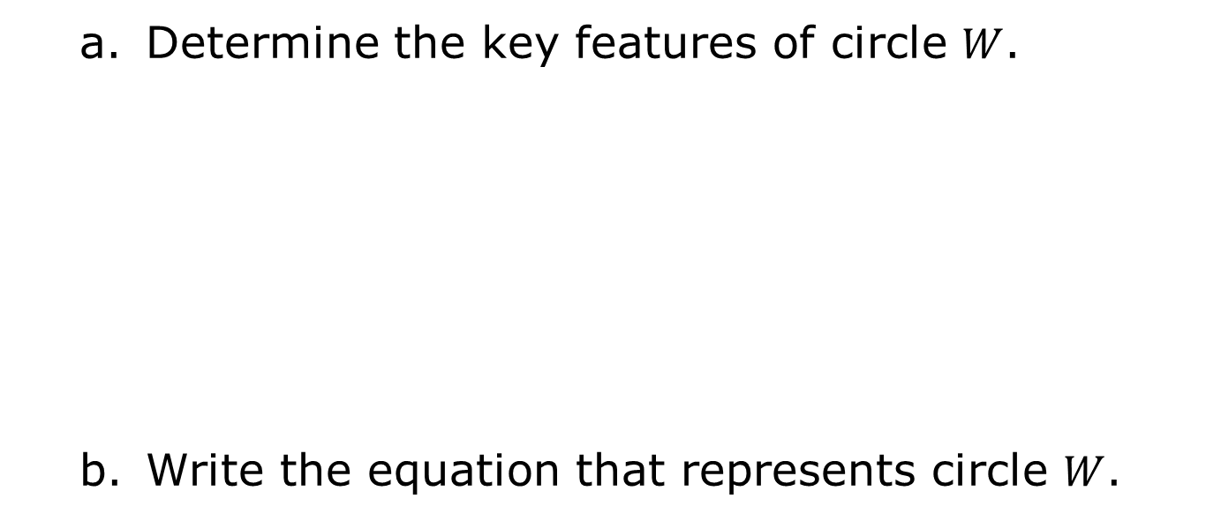
Determine the key features of circle $W$.
Write the equation that represents circle $W$.
Key Features
Radius
Center
volume 2, pg. 266

